Slide 1
Oracle E-BS Architecture & Application Object Library

Slide 2
What to Expect from the session
After the session there will be clear understanding of below mentioned topics
File Server Structure
Database structure
Commonly Used AOL Objects:
User Responsibilities
Concurrent Programs
Menus
Request Group
Request Set
Profile Options
Value Sets
FND Messages
Flex Fields

Slide 3
Topics
File server Structure And Setting Up Your Application
User Responsibilities / Concurrent Programs
Register Forms/ Register Function / Menus/Messages
Request Group
Profiles
Value Set
Flex Fields

Slide 4
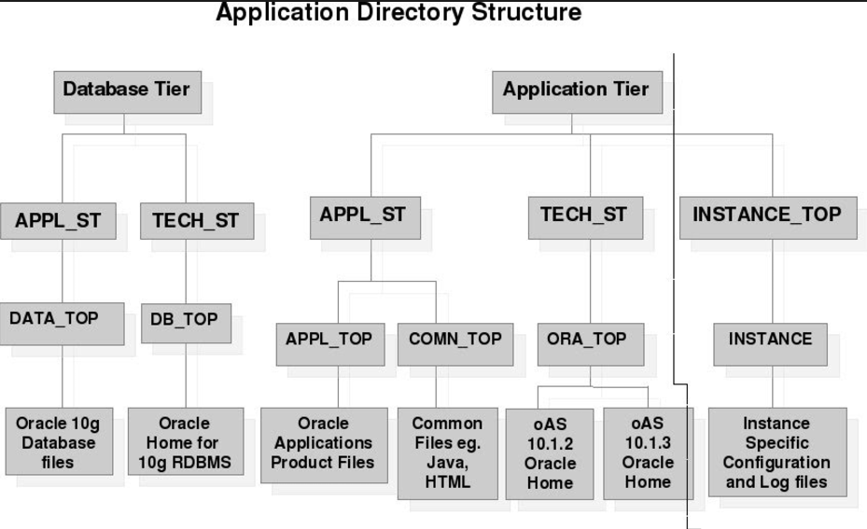
File server structure

Slide 5
Setting Up Your Application
Oracle Applications and custom applications that integrate with Oracle
Applications need to have a particular directory structure where its
components must be available. Those components are,
Forms
Menus
Programs
Reports

Slide 6
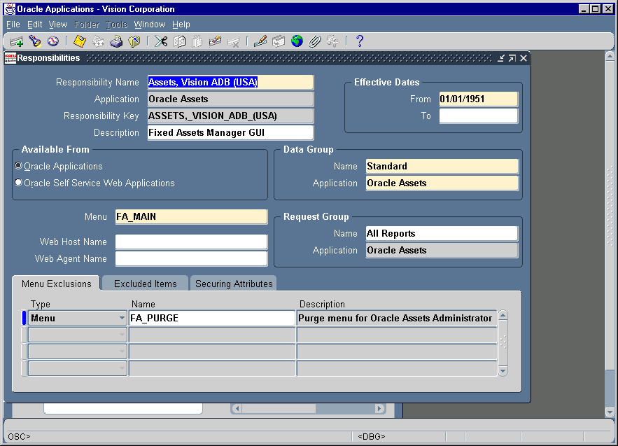
Responsibility
A responsibility is a set of authority in Oracle Applications that lets users access only those functionality of the application appropriate to their role.
How much of an application’s functionality a user can use
What reports and concurrent program a user can access
Which application data these reports and concurrent programs can access.

Slide 7
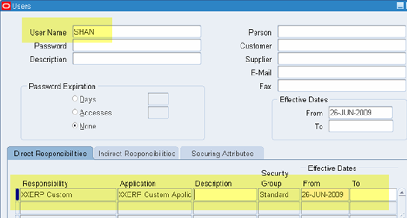
Create Users and assign Responsibilities
Switch to System Administrator responsibility
Navigate to Security-->User-->Define
Add or query an User.
Add responsibility to user as required.

Slide 8
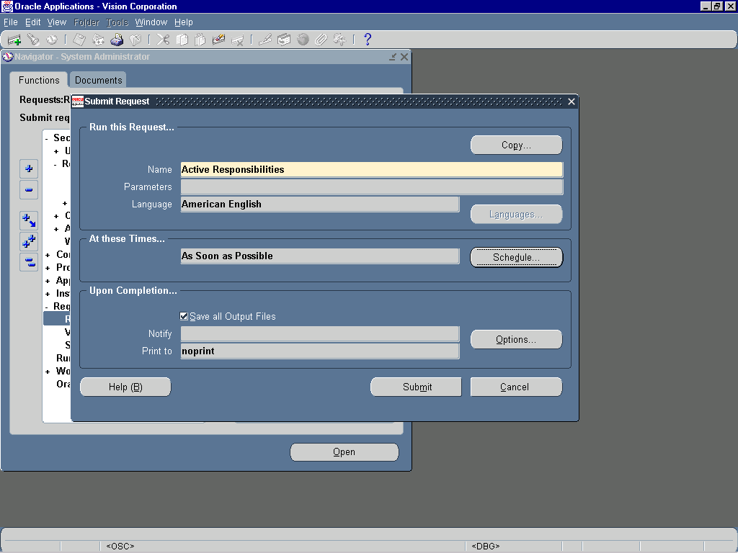
SRS Form
Then use SRS (Standard Report Submission) form for running and monitoring your application’s reports/concurrent programs at specific time interval.
This lets user specify run and print options and parameter value for reports and concurrent programs.
Use fnd_file.put_line(fnd_file.log, ‘any message’) to show message in conc program log file

Slide 9
Concurrent Program
A concurrent program is an executable file that runs simultaneously with online operations and with other concurrent programs. We need a concurrent program for ..
Any long running data intensive program
Operating system script
Oracle Reports
The various steps to define and register a concurrent program are..
Define concurrent program executable
Define concurrent program
Include the concurrent program in a request group
Run concurrent program through submit request form.

Slide 10
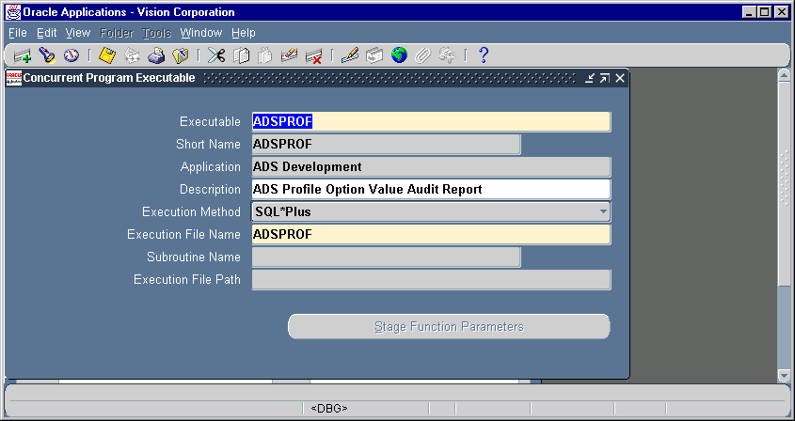
Concurrent Program Executable
Enter a name for executable and short name.
Choose the application to which this
executable belongs such that the system will
look for this file in that directory structure.
Enter the execution method as
SQL* Plus : sql files with anonymous sql blocks
PL/SQL Stored Procedure
Host
Oracle Reports
Enter the execution file name without the file extension.
For PL/SQL stored procedures enter the <package>.<procedure name> in the execution file name. This procedure must have 2 out parameters of type varchar2 preferably with names errbuf and errout. These two parameters should be added before adding any other parameters.

Slide 11
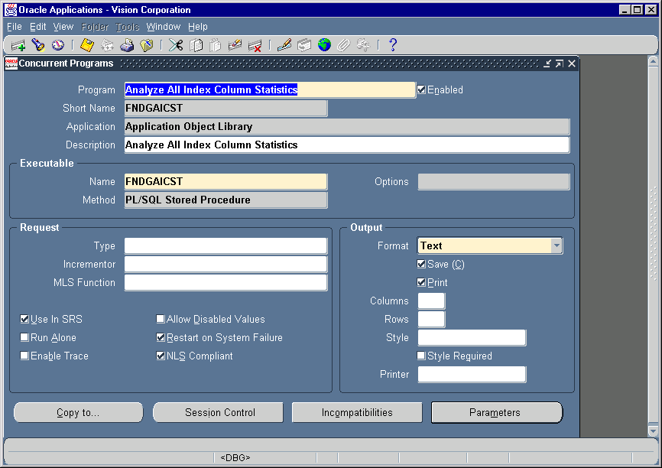
Concurrent Program
Define a concurrent program,
Choose an executable created, which will be executed once this concurrent program is scheduled to run.

Slide 12
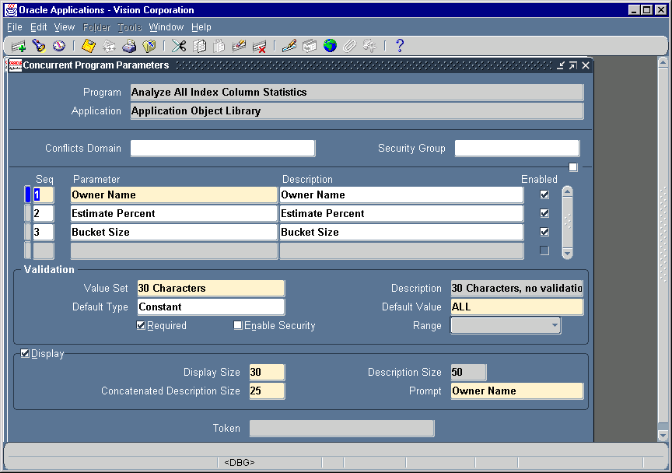
Define Concurrent Parameters
The parameters are the placeholders for the input values to a concurrent program.
If the execution method of a concurrent program is Oracle Reports then each parameter is linked to the actual report parameter via the “Token” field in the parameters window
For PL/SQL stored procedures these parameters are passed to the progam by position

Slide 13
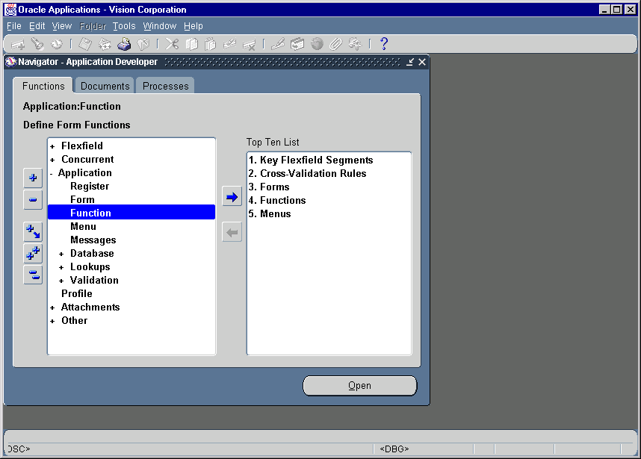
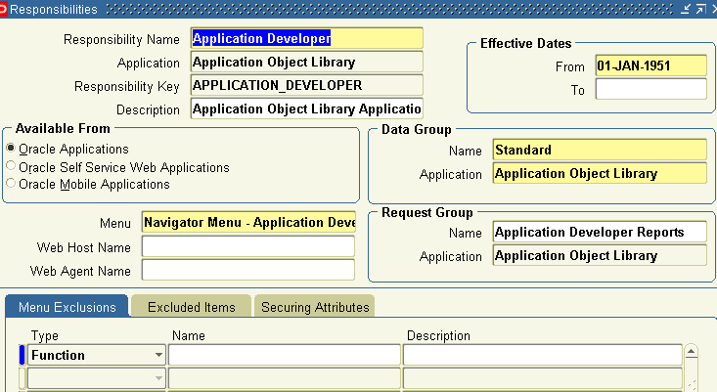
Menus
A menu is a hierarchical arrangement of application functions, that is displayed in the navigator window.
A menu consists of menu entries , which could be a submenu or a function.
Form functions are selected and navigated to using Navigator window.
Each responsibility has a menu associated with it.
Note the Menu name associated with a responsibility.

Slide 14
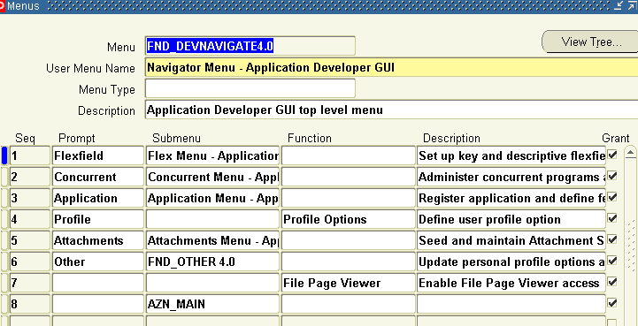
Menus (Contd.)
Query the menu name to find the menu entries.
Add your functions as menu entries here or create a new menu with your functions and add that as a sub- menu here.
Now you switch the responsibility and check whether your menu entry is appearing in corresponding responsibility.

Slide 15
FND_MESSAGE
FND_MESSAGE is used to define messages in oracle application
Use the FND_MESSAGE.SET_NAME, FND_MESSAGE.SET_TOKEN, and FND_MESSAGE.GET routines to get the message into a buffer. Or, use FND_MESSAGE.GET_STRING to get a single message into a string.
The Navigation for the messages is Application Developer -> Application -> Messages.

Slide 16

Define Request Group
Note the Request group name for the responsibility, with which you want to attach the concurrent program.

Slide 17
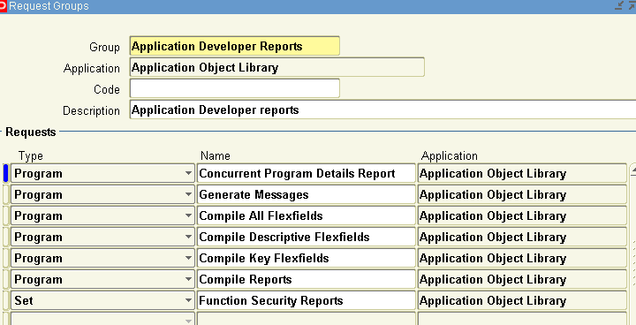
Define Request Group (Contd.)
Query the request group and add your concurrent program to the group.
A request group is a collection of reports and concurrent programs.
A system administrator defines request group in order to control user access to reports and concurrent programs.

Slide 18
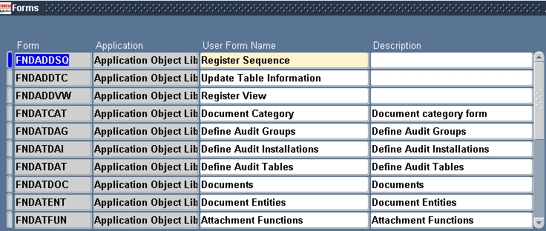
Register Forms
A form is a user interface to insert ,update and delete data into and from database. After development , a form must be registered with Oracle Application Object Library.
A form executable (the fmx file) should be placed under the proper application top directory eg. XXX_TOP/forms/US where XXX is the application short name for a given application.

Slide 19
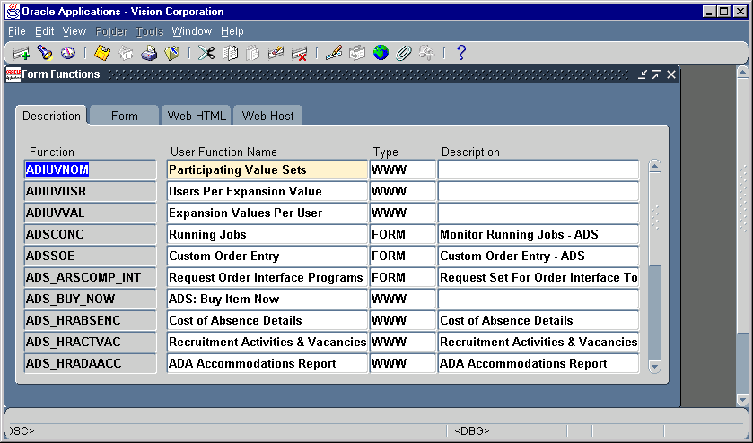
Register Functions
A function is a part of an application functionality that is registered under a unique name for the purpose of assigning /excluding it from a responsibility.
Application developers register functions when they develop forms.

Slide 20
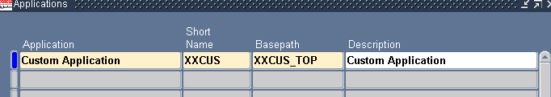
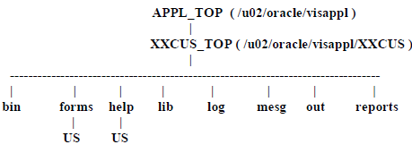
Registering Custom Application
Register your custom application with the Application Object Library.
Switch to System Administrator responsibility and open ‘Applications’ form.
Register a custom application with name, short name and Base path.
In Unix, create a custom directory tree for your custom schema under APPL_TOP. First create a directory XXCUS which will serve as the base path then create other subdirectories as..
Modify the applications environment file to include the custom schema base path as XXCUS_TOP="/u02/oracle/visappl/XXCUS"
export XXCUS_TOP

Slide 21
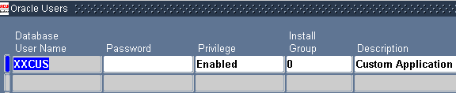
Registering Custom Schema
First create an user in the database using SQL*Plus under the system account.
For example:
$ sqlplus system/systempword
SQL> create user XXCUS identified by CUST default tablespace USER_DATA temporary tablespace TEMP quota unlimited on USER_DATA quota unlimited on TEMP;
SQL> grant connect to XXCUS identified by CUST;
Then Register the user with the Application Object Library.
Log into Oracle Apps as the System Administrator and navigate to Security -> ORACLE -> Register.
Notes:
Onsite teams aligned to Client IT and Business domains
Offshore team – part dedicated to Domains and technology pool of similar technologies who work across domains
Supported BY testing and Quality
Supported by Innovation council and COE’s

Slide 22
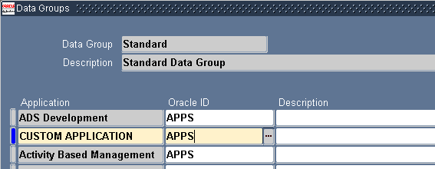
Add custom schema to data group
Log into Applications as the System Administrator and navigate to Security -> ORACLE-> DataGroup.
It is recommend that you use the STANDARD datagroup and associate the custom schema with APPS.
Now you can create your custom tables, indexes and sequences in custom schema.
Then Grant ALL access to APPS.
Create Synonyms, views, triggers and Packages in APPS schema.

Slide 23
User Profile
A profile is a set of changeable options that affects the way your application runs
System Profile Options
Set by the System administrator
User can not change
Any change in the system profile becomes effective only when the user logs on again or change responsibility
Personal Profile Options
Set by the System Administrator
User can change the option values
Any changes become effective immediately
You need to create a profile in Application Developer responsibility and then assign its system and personal values.

Slide 24
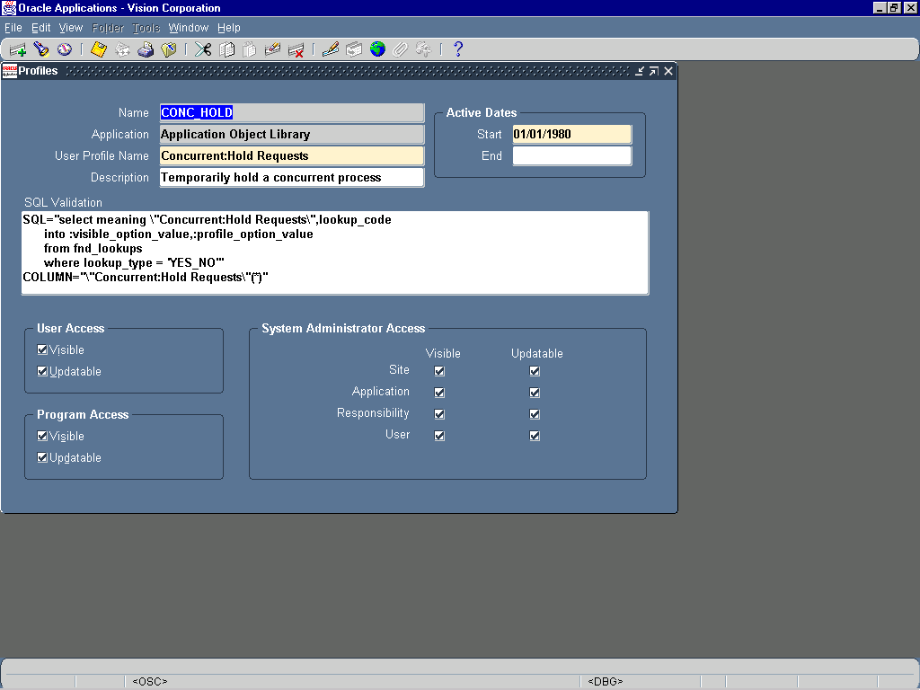
User Profile Forms
Define new user profile option at the time of developing a new application
Profile names must be unique
A profile option can not be deleted

Slide 25
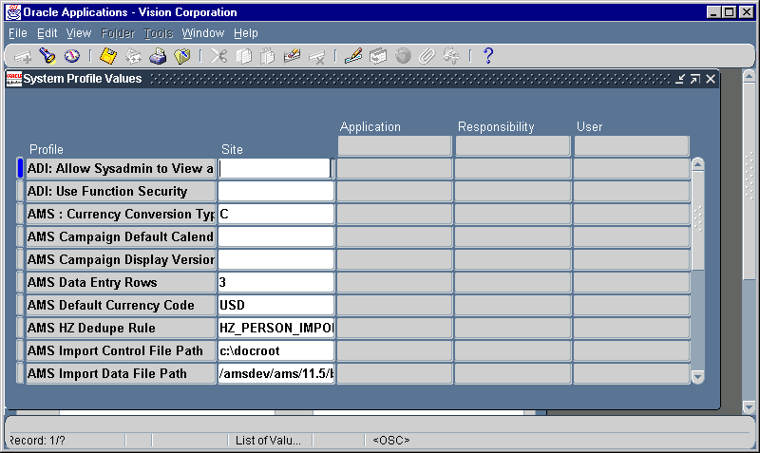
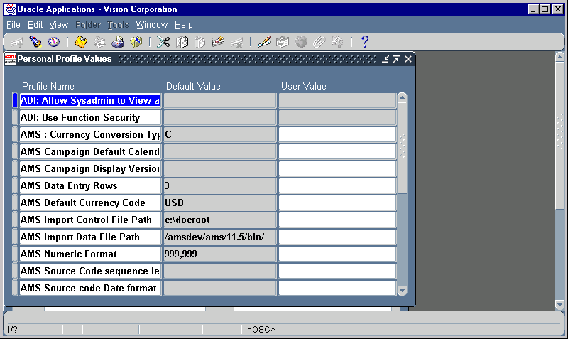
Setting Profile Values
Setting System Profile
Values
Navigate to
Sysadmin → Profiles
Setting Personal Profile
Values
Click on Menu Edit->Preferences-> Profile

Slide 26
User Profile
User Profile Levels
A value set at the higher level overrides the one set at the lower level. “User” is the highest level.
After implementation System Administrator sets the default profile values at the site level
Option values are dynamically set at the run time
User -1
Responsibility - 2
Application - 3
Site - 4
Level Hierarchy

Slide 27
User Profile Routines
User Profile routines that helps in retrieving option values are,
FND_PROFILE.GET (name IN varchar2,value OUT varchar2) is a procedure.
FND_PROFILE.VALUE (name IN varchar2) return varchar2 is a function.
Syntax of referring a profile option value in value sets or concurrent program parameters is :$PROFILES$.option_name
Seeded profiles are
USERNAME
USER_ID
RESP_ID

Slide 28
Value Sets
Use value set to
Determine which values users can enter into flexfield segments and concurrent program parameters.
Provide a list of valid values using list of values feature
Validation Type for Value Set
None (not validated at all)
Table
Independent
Dependent

Slide 29
Table validated value sets
Create a validation table in your database
Register your table with Oracle Application Object Library (as a table)
Create the necessary grants and synonyms
Define a value set that uses your validation table
Define your flexfield structure to use that value set for a segment.

Slide 30
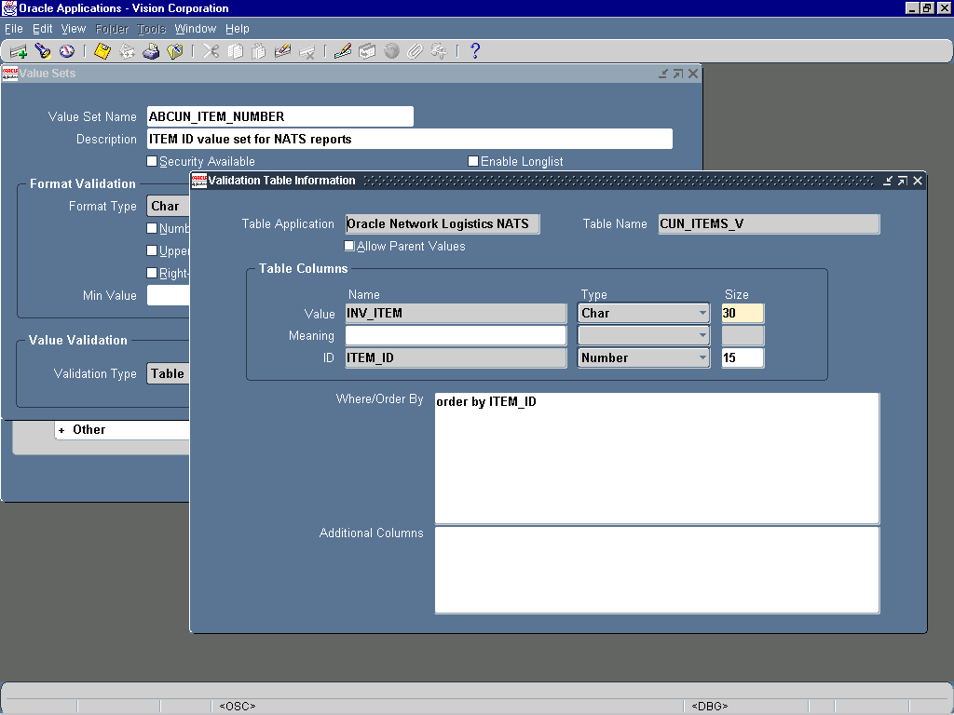
Table validated value sets (Contd.)
Create a value set with a name ,format type and length.
Specify validation type as Table and click on details button
Enter the Application name (optional), table name.
Enter the column names which you want to display as value and meaning (optional)
Enter the column name which need to be stored in the database in ID field
Mention the data type of these columns
Enter a where and order by clause as appropriate.

Slide 31
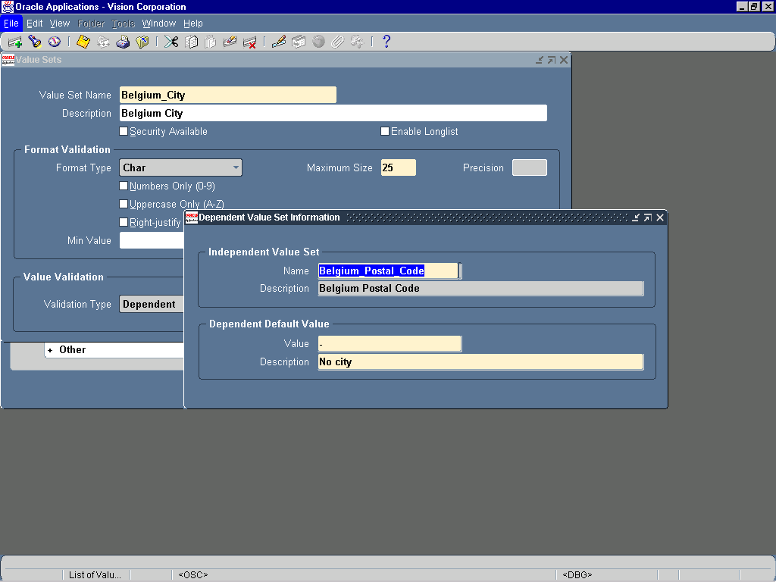
Independent/Dependent Value Set
Create your independent value set first
Create your dependent value set, specifying a default value
Define your independent values
Define your dependent values

Slide 32
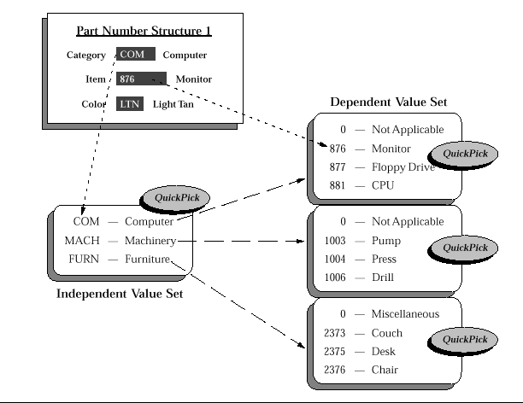
Value Sets (Contd.)
Validation Type for Value Set…
Dependent

Slide 33
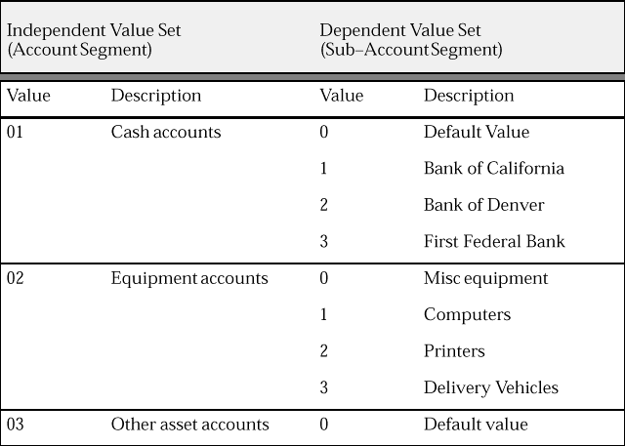
Relationship Between Value Sets

Slide 34
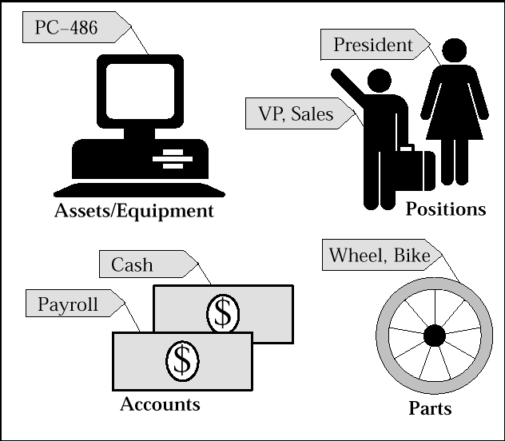
Key Flexfields
Most businesses use codes made up of meaningful segments to identify Account Number, Part number and other business entities, eg: a company might have a part number ”PAD–NR–YEL–8 1/2x14” indicating a notepad, narrow–ruled, yellow, and 14” by 8 1/2”.
A Flexfield is a field which is made up of segments.
Each segment has a name and a set of valid values
A Key flexfield identifies an entity

Slide 35
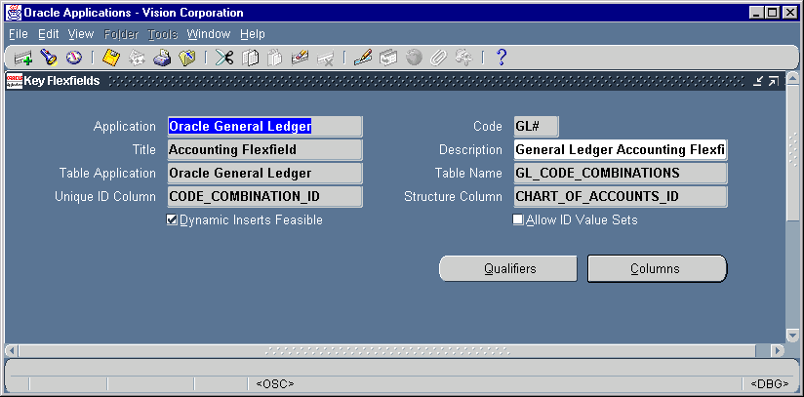
Register Key Flexfields
Register your key flexfield with Oracle Application Object Library
Each key flexfield has one corresponding table, known as the combinations table, where the flexfield stores a list of the complete codes, with one column for each segment of the code.
There is a corresponding unique ID number (a code combination ID number or CCID) for that code which is also stored in the combination table.
A flexfield structure is a specific configuration of segments. Same flexfield can have multiple segment structure

Slide 36
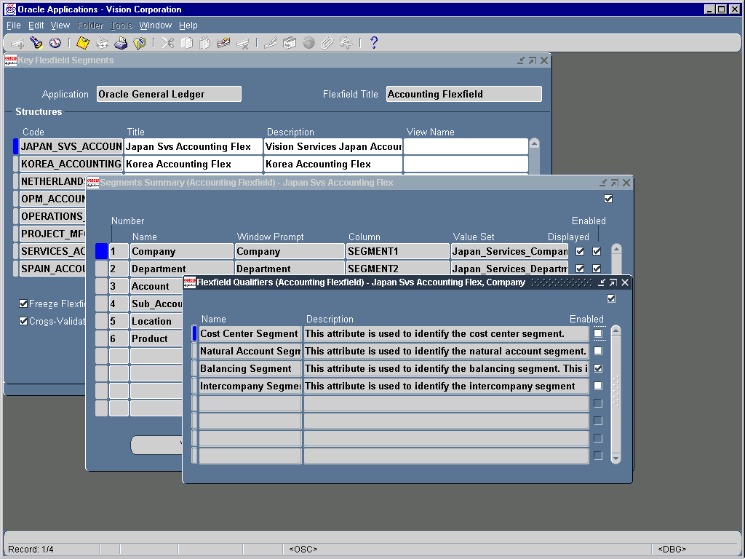
Customize Key Flexfield Segments
A segment is a single sub–field within a flexfield. You define the appearance and meaning of individual segments when customizing a flexfield.
A segment is represented in your database as a single table column.
Flexfield validates each segment against a set of valid values, which are mostly predefined
A flexfield qualifier identifies a particular segment of a key flexfield.

Slide 37
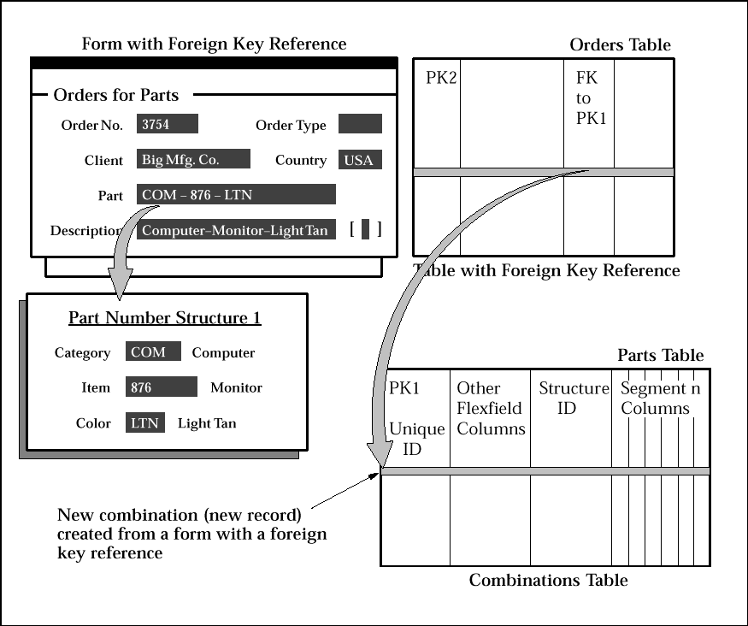
Key Flexfield Feature
Dynamic Insertion
The insertion of a new valid combination into a combinations table from a form other than the combinations form.

Slide 38
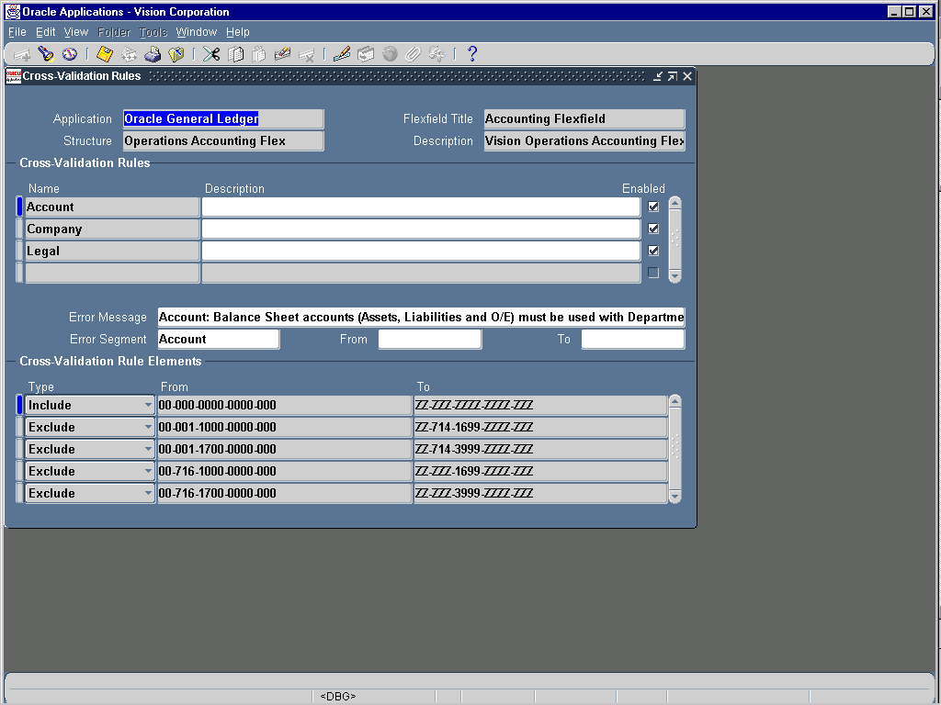
Key Flexfields Cross Validation
Cross–Validation
Cross–validation rules prevent users from creating new key flexfield combinations that contain values that should not coexist in the same combination.

Slide 39
Descriptive Flexfields
Descriptive flexfields provide customizable "expansion space" on your forms. You can use descriptive flexfields to have additional information, important and unique to your business, that would not otherwise be captured by the form.
A descriptive flexfield appears on a form as a single-character, unnamed field enclosed in brackets.
Descriptive flexfields have two different types of segments, global and context-sensitive.
A global segment is a segment that always appears in the descriptive flexfield pop-up window.
A context-sensitive segment is a segment that may or may not appear depending upon what other information is present in your form.

Slide 40
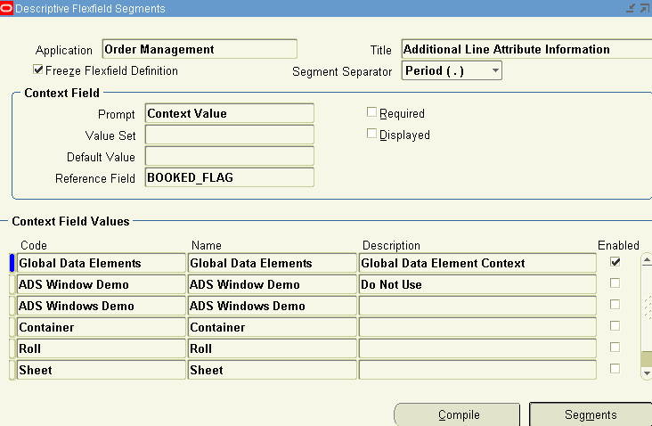
Global Segments
In Order management, if you want to add some extra Order line information, then query the DFF for “Additional Line Attribute information”
Go to Global Data Elements context field.
Click segments to view the DFF segments.

Slide 41
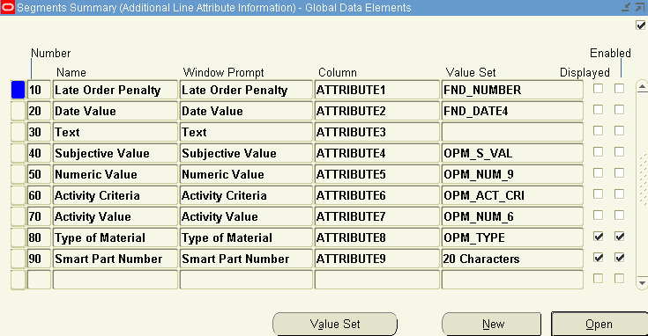
Global Segments (Contd.)
Already used segments for the DFF will appear here
You can create a new record and use a previously unused attribute and make it enabled and displayed
Save and compile the flexfield definition

Slide 42
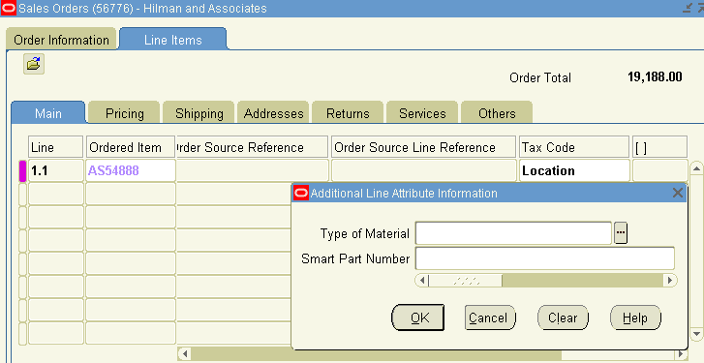
Global Segments (Contd.)
Navigate to Order Management, Enter orders screen.
Enter or query an order and go to line DFF
You can see the additional information you enabled now
The DFF data gets stored in attribute columns of the base table.

Slide 43
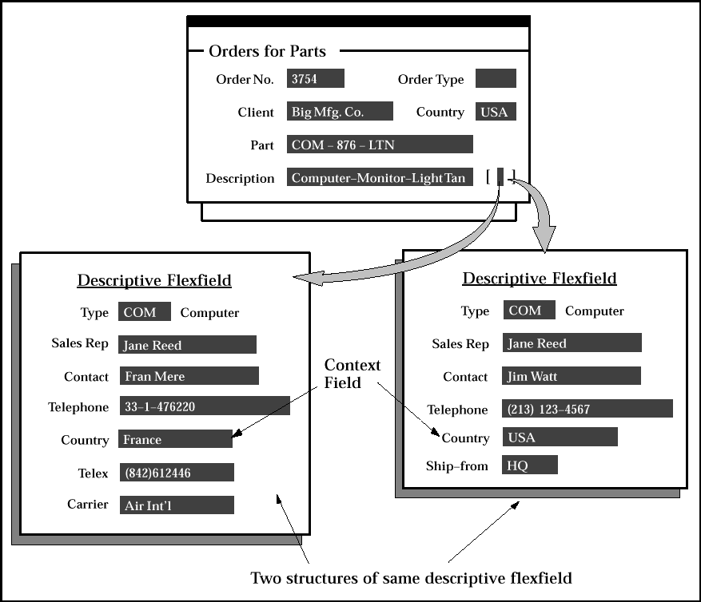
Context sensitive Segments
A context-sensitive descriptive flexfield can gather context information from either a field on the form, or from a special field (a context field) inside the descriptive flexfield pop-up window.
If the descriptive flexfield derives the context information from a form field, that field is called a reference field for the descriptive flexfield.
In DFF Segments form check Displayed for the context.
Optionally change the prompt of context
Choose the reference field from LOV, which should be initially defined in Register DFF form
Global Segments
Context Field
Context-Sensitive Segments

Slide 44
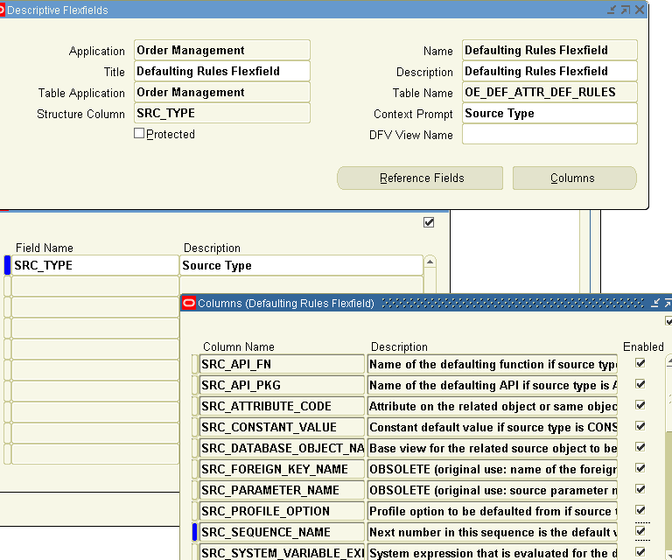
Context sensitive Segments (Contd.)
The reference field is same as a normal form field.
Reference fields provide a way to map the context-sensitivity of descriptive flexfield information that has been captured to existing conditions in your business data.

Slide 45
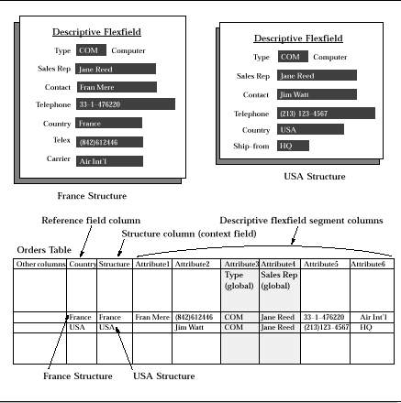
Context sensitive Segments (Contd.)
Descriptive flexfield segments...
Multiple Structure
Reference field
Structure Column

Slide 46
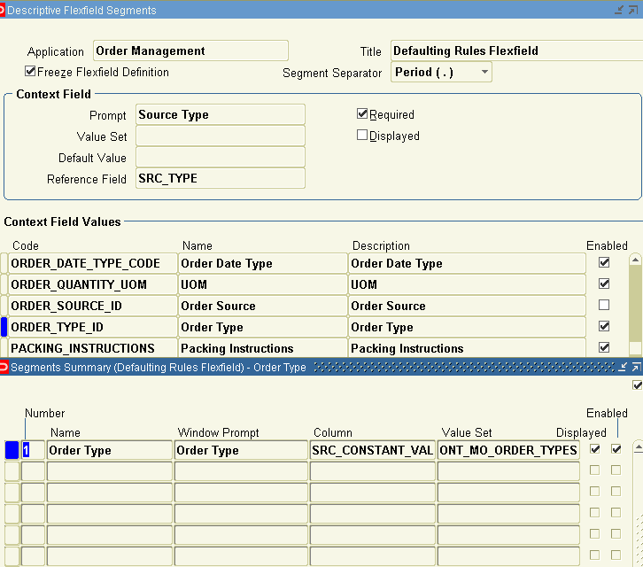
Context sensitive Segments (Contd.)
If you use a reference field, the value of that field populates its own column. For example, if the reference field on the form is the "Country" field, it populates the "country" column in the table.
However, the reference field value also populates the structure (context) column in the table, since that value specifies which structure the flexfield displays.

Slide 47
Benefits of Flexfields
Flexfields provides features that are required to satisfy the following business needs:
Customize your applications to conform to your current business practice for accounting codes, product codes, and other codes.
Customize your applications to capture data that would not otherwise be tracked by your application.
Have “intelligent fields” that are fields comprised of one or more segments, where each segment has both a value and a meaning.
Rely upon your application to validate the values and the combination of values that you enter in intelligent fields (Cross Validation Rules).
Have the structure of an intelligent field change depending on data in your form or application data.
Customize data fields to your meet your business needs without programming.
Query intelligent fields for very specific information.

Slide 48
References
Oracle Applications Documentation library - Oracle Applications Developer's Guide,
http://download-uk.oracle.com/docs/cd/B25516_08/current/html/docset.html

Slide 49
Questions and Answers

